Slide 1

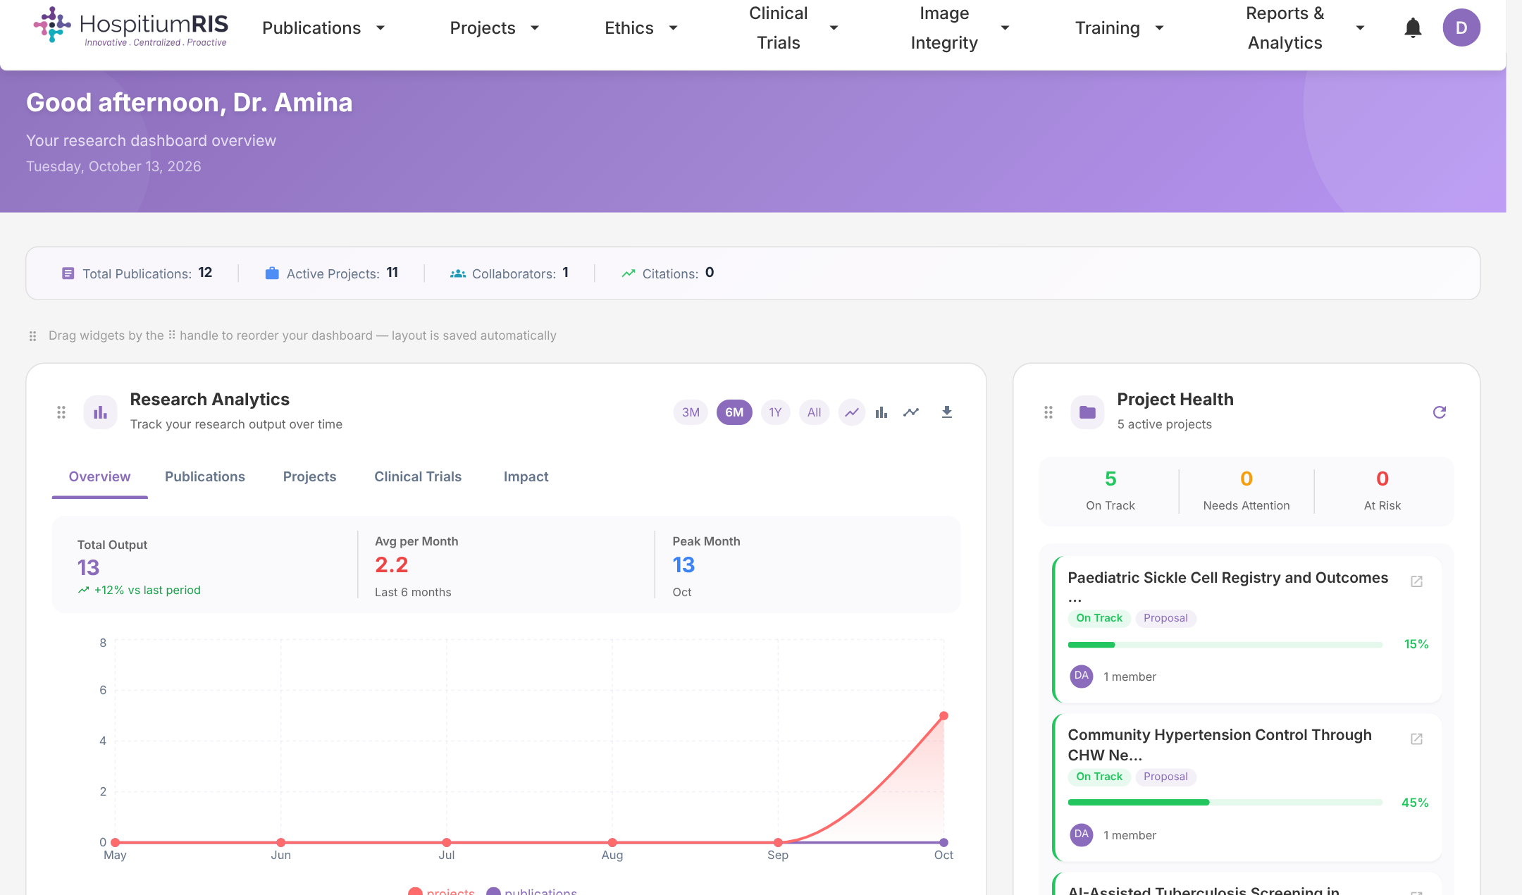
AI-POWERED RESEARCH INFORMATION SYSTEM
Transforming Hospital Research Management
One secure platform that takes every study from proposal to publication — and proves its impact.
Developed by TCC Africa · hospitium.hospitiumris.org
Notes:
Open with the headline: HospitiumRIS is a Research Information System built specifically for hospitals, medical schools and health research organisations. Developed by TCC Africa, it brings proposals, ethics, grants, clinical trials, manuscripts, publications and impact reporting into one platform. Today I will show you the problems it solves, who it serves, and the product itself.

Slide 2
What we will cover
01
The challenge
02
Our value proposition
Why health research is hard to see, fund and govern today
One platform for the full research lifecycle, built for every type of health research institution
03
Product tour
04
AI integration
Real screens: dashboards, publications, manuscripts, proposals, ethics and trials
What the built-in AI does today and how it helps every role
05
Trust & deployment
06
Getting started
Integrations, security, hosting options and the change for your institution
Onboarding plan and next steps toward a pilot
Notes:
Set expectations for the session: about 30 to 40 minutes, with a live demo optional after the product tour. Call out section 4 — AI integration — as something most research information systems do not offer out of the box.

Slide 3





Health research is happening, but it is hard to see and hard to govern
Fragmented data
Manual, error-prone reporting
Low visibility
Compliance pressure
No central researcher profiles
Proposals, approvals and outputs sit in spreadsheets, inboxes and departmental folders.
Every board report or funder update means chasing researchers for numbers.
Your institution's publications and expertise are hard for funders and partners to find.
Ethics approvals, trial registrations and audit trails are tracked by hand.
Nobody has one up-to-date view of who does what, with whom, and with what impact.
The result: slower approvals, missed funding, and research output that never gets the credit it deserves.
Notes:
Ask the prospect which of these they recognise. Most teaching hospitals and universities experience all five: data spread across departments, reports compiled manually, poor visibility of outputs, ethics and compliance tracked on paper or spreadsheets, and no single source of truth about their researchers. Pause here and let them describe their own version of the problem.

Slide 4







OUR VALUE PROPOSITION
One secure platform for the entire research lifecycle — so your institution can run research faster, stay compliant, and show its impact.
Propose
Ethics
Fund
Run & trial
Write
Publish
Measure
Centralised
Compliant
Visible
Every proposal, approval, grant, trial and paper in one place, with a single researcher profile.
Built-in ethics review, trial registry exports, image integrity checks and audit trails.
ORCID, Crossref and DataCite links plus AI-powered analytics that turn activity into reportable impact.
Notes:
This is the core message. HospitiumRIS covers the full lifecycle: an idea becomes a proposal, gets ethics approval, gets funded, runs as a project or clinical trial, is written up collaboratively, is published, and its impact is measured. Because it all happens in one system, the institution gets three outcomes: everything is centralised, compliance is built in rather than bolted on, and research output becomes visible to funders, partners and leadership.

Slide 5







Who uses HospitiumRIS?
Built for the full spectrum of health research institutions — from small research units to national referral hospitals.
University Teaching Hospitals
Medical Schools
Clinical Trial Centres
Ethics Review Boards
Run research, ethics and trials alongside clinical care.
Track faculty output, proposals and student research.
Registry-ready trials, recruitment and safety reporting.
Online applications, committee review and approval tracking.
Health Research Institutes
Health Ministries
Research Support Offices
International Research Partners
Manage projects, grants, datasets and publications.
National view of research activity, compliance and impact.
Review pipelines, grant tracking and reporting on demand.
Collaborate across institutions on shared projects and outputs.
Notes:
HospitiumRIS is built for the full spectrum of health research institutions, from small research units to national referral hospitals. Point to the two or three types that match the prospect: a university teaching hospital will care about running research alongside clinical care; an ethics review board about online applications and approval tracking; a health ministry about a national view of research activity and compliance. Every type works on the same shared research record, which removes duplicate entry and reporting effort.

Slide 6



How it fits together: one data core, four workspaces
Every user works in a portal designed for their role, on the same shared, permissioned research record.
Researcher portal
Institution portal
Profile, publications, manuscripts, proposals, ethics, trials, training
Review pipelines, ethics boards, trial oversight, analytics, users
HospitiumRIS research record
People · projects · proposals · ethics · trials · grants · manuscripts · publications · datasets
Foundation portal
Platform administration
AI insight layer
Grant calls, internal requests, tracking, campaigns, donors, reports
Institutions, verified domains, security, logs, system health
Notes:
This slide explains the architecture in business terms. There is one research record at the centre — people, projects, proposals, ethics, trials, grants, manuscripts, publications and datasets. Each audience gets its own portal on top of that record, with permissions that control what they see. The AI layer reads from the same record to produce summaries and insights, so it always works on current data.

Slide 7




A personal command centre for every researcher
Everything a researcher needs, the moment they log in.
Live research analytics
Output trends across publications, projects and trials.
Project health at a glance
On-track, needs-attention and at-risk projects, with progress.
Customisable layout
Drag-and-drop widgets; the layout is saved per user.
19 languages
Including English, Swahili, French, Arabic and Portuguese.
Notes:
This is the researcher home screen. Point out the personalised greeting, the research analytics chart, and project health on the right. Researchers can rearrange widgets and the layout is remembered. The interface is available in 19 languages, which matters for multi-country networks and francophone or lusophone partners.

Slide 8
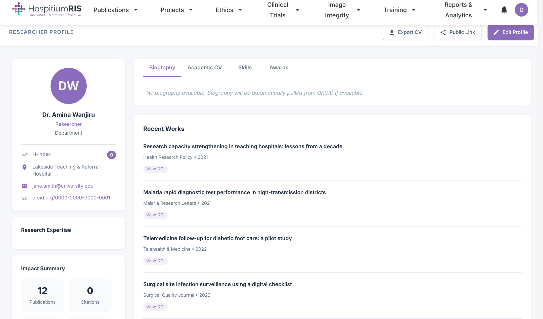




Researcher profiles that build themselves
A living CV for every researcher, kept current by the platform.
ORCID-linked identity
Profiles connect to ORCID so names, affiliations and works stay accurate.
One-click CV export
Academic CV, skills and awards ready for grant applications.
Public profile link
Share expertise with funders and partners to raise visibility.
Impact summary
Publications and citations roll up automatically from the library.
Notes:
Every researcher gets a profile that fills itself from their publications and ORCID record. They can export an academic CV for grant applications and share a public profile link. For the institution, this becomes a searchable directory of expertise — useful for finding reviewers, collaborators and principal investigators.

Slide 9
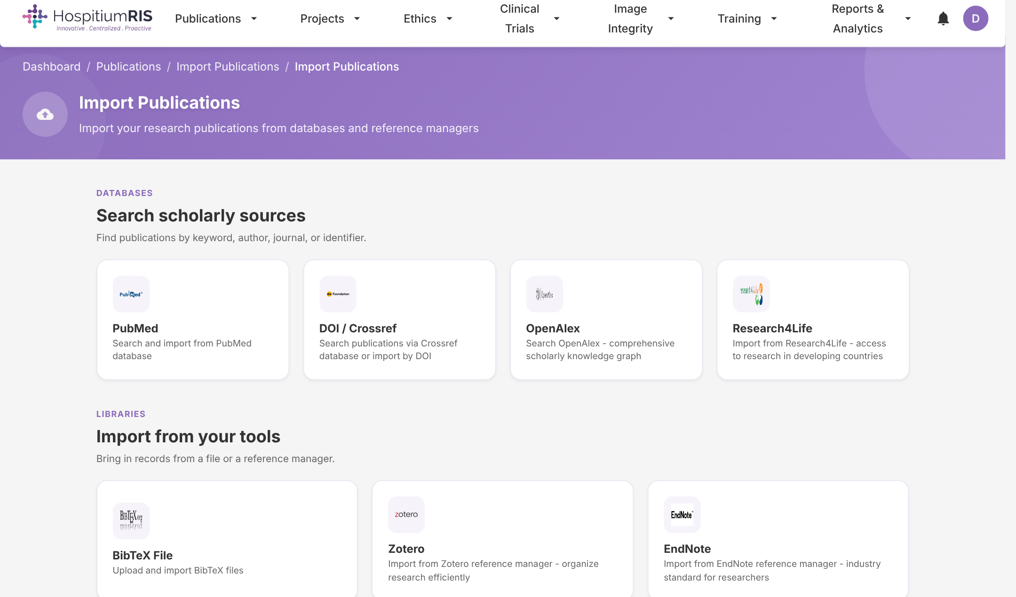


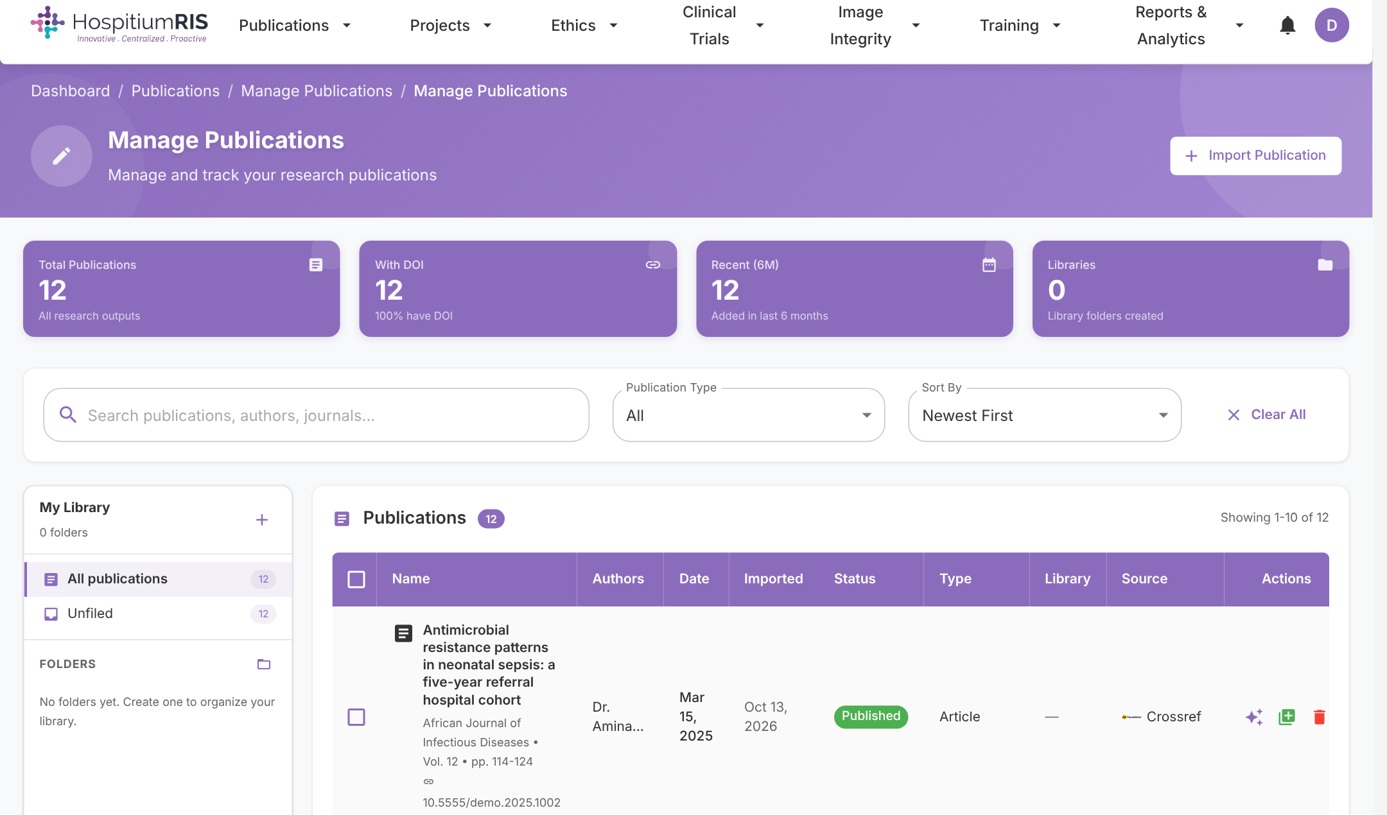


Publications and citations, without the busywork
One-click import
PubMed, Crossref/DOI, OpenAlex and Research4Life.
Bring existing libraries
BibTeX, RIS/EndNote, Mendeley, Zotero and CSV.
Cite as you write
APA, MLA, Chicago, Harvard, Vancouver, IEEE and AMA.
Organised and deduplicated
Folders, filters and DOI matching keep libraries clean.
Notes:
Researchers can pull in their entire publication record in minutes from PubMed, Crossref, OpenAlex and Research4Life, or upload existing libraries from EndNote, Mendeley, Zotero or BibTeX. Duplicates are matched by DOI. For the institution, this means a complete, clean publications register with no manual data entry.

Slide 10
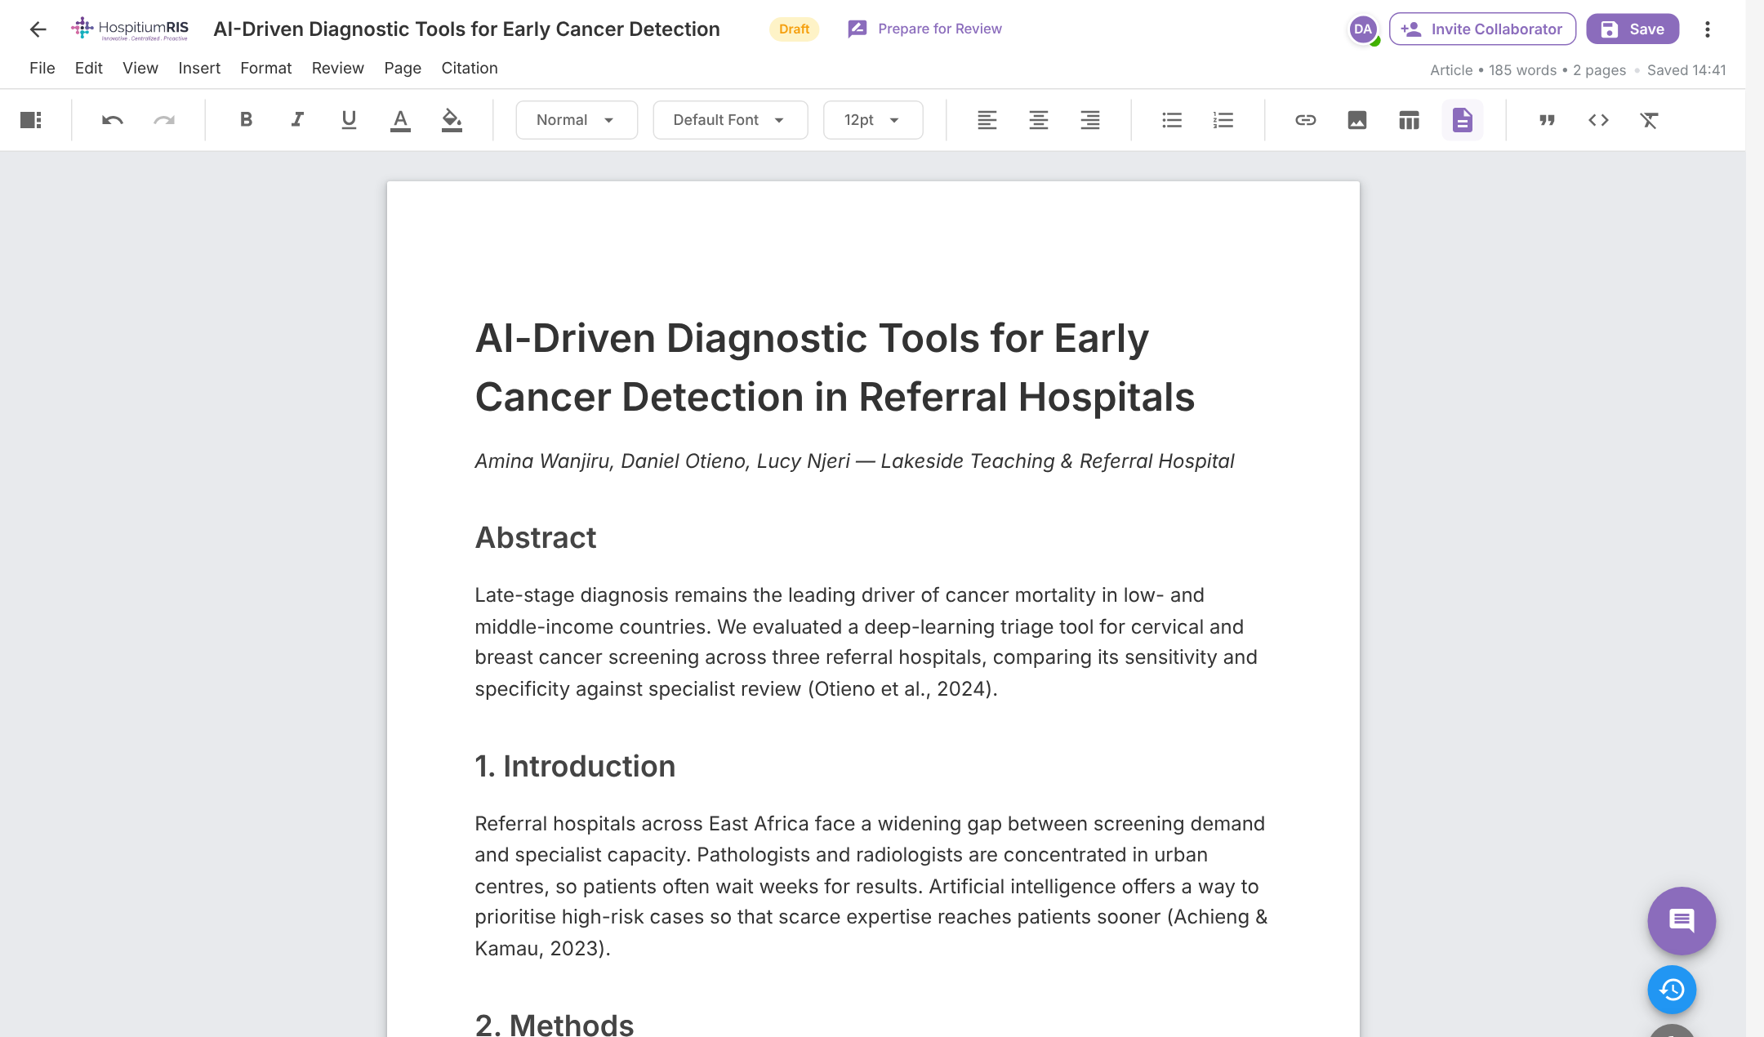




Write together, in real time, inside the platform
A full manuscript editor with collaboration built in.
Invite by ORCID or email
Owner, admin, editor, contributor and reviewer roles.
Track changes & comments
Accept or reject edits; threaded comments and suggestions.
Version history
Automatic and manual snapshots you can restore.
Integrated citations
Insert from your library; bibliography builds itself.
Notes:
Manuscripts are co-authored inside HospitiumRIS, so drafts stop living in email attachments. Collaborators are invited by ORCID or email with role-based permissions, see each other online, and use track changes, comments and version history. Citations come straight from the publication library. When a paper is ready, it moves into review and, once published, links back to the proposal and project it came from.

Slide 11
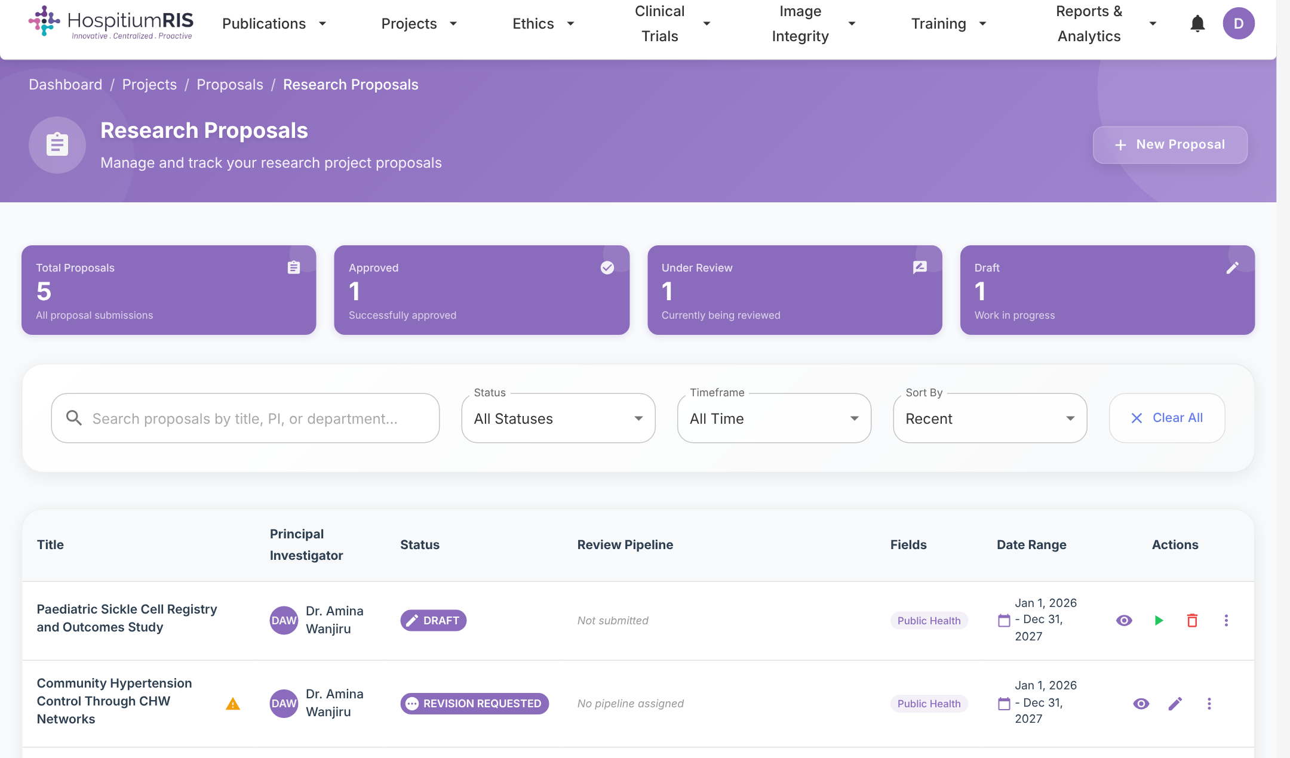
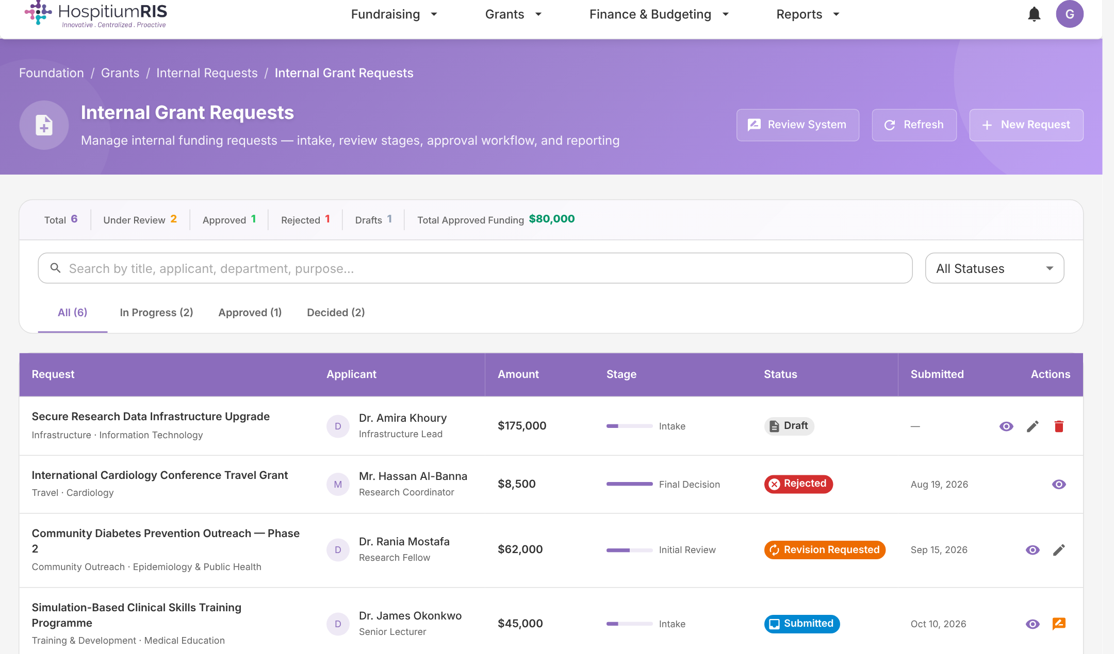
From proposal to funded project, with a clear audit trail
For researchers
For research offices & foundations
Structured proposal templates with budgets, milestones, co-investigators, data management plans and linked ethics approvals.
Configurable multi-stage review pipelines, internal grant requests, grant tracking from application to award, and donor campaigns.
Notes:
Left: the researcher view of proposals, with status, review pipeline and budget. Right: the foundation or research-office view of internal grant requests moving through intake, review and final decision. Review stages are configurable per institution. Every decision is recorded, which gives leadership and funders a clean audit trail and makes it easy to see where proposals are stuck.

Slide 12
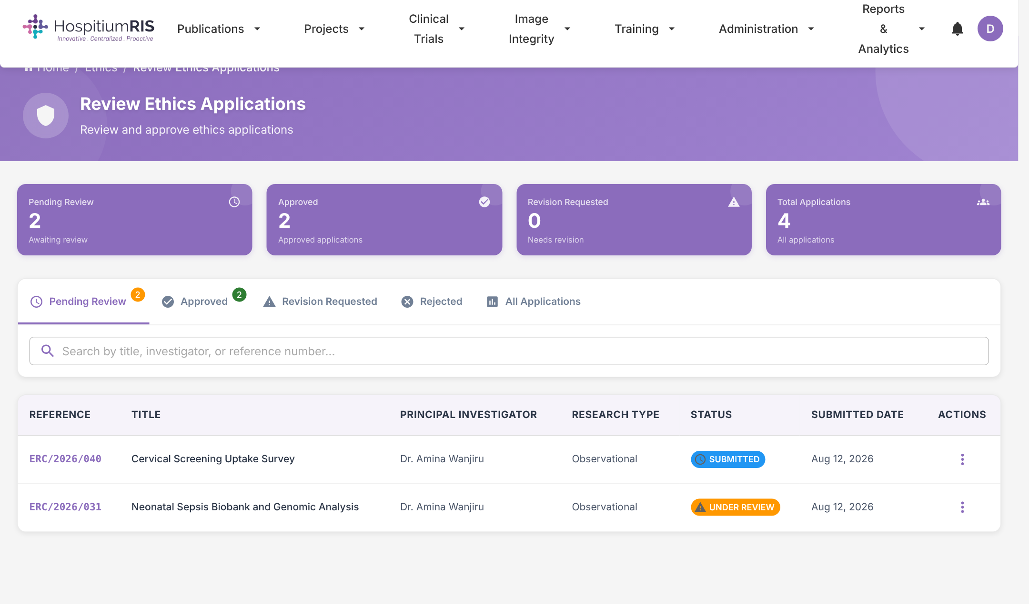
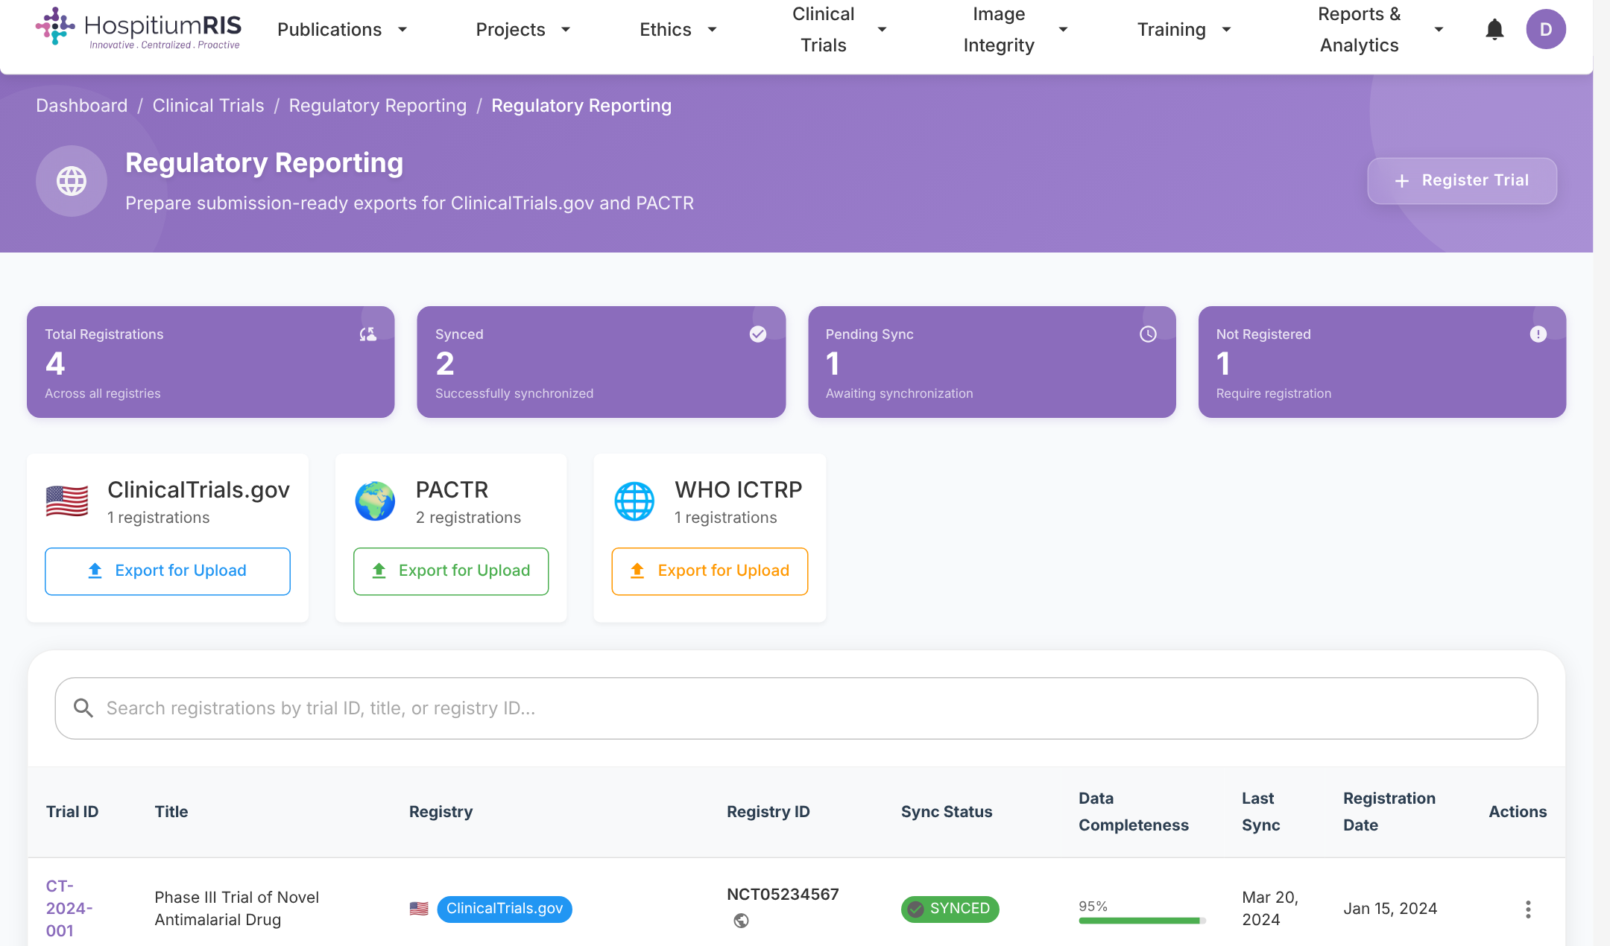



Compliance built in: ethics, clinical trials and integrity
Ethics applications & review
Registry-ready trials
Image integrity screening
Online submission, committee review, conditions and expiry tracking.
Export for ClinicalTrials.gov, PACTR and WHO ICTRP; recruitment and safety logs.
Check manuscript images for duplication or manipulation before submission.
Notes:
For hospitals and clinical research units this is often the deciding slide. Ethics applications are submitted and reviewed online, with reference numbers, conditions and expiry dates tracked automatically. Clinical trials can be exported in the formats required by ClinicalTrials.gov, the Pan African Clinical Trials Registry and WHO ICTRP. Image integrity screening helps the institution catch problems before a paper goes out, protecting its reputation.

Slide 13




AI INTEGRATION
AI built into the research workflow, not bolted on
Six AI and automation capabilities already live in HospitiumRIS, working on your own research record.
Publication summaries
Impact insights
Compliance insights
Structured AI summaries of any paper: overview, key findings and significance, plus extracted keywords. Works in batches.
Narrative explanation of citation and output trends, growth recommendations and a standout-publication callout.
Flags expiring ethics approvals, overdue training and image-integrity findings, with a priority to act on.
Project & grant insights
Image integrity detection
Automated pre-review
Reads the proposal and grant pipeline to surface stuck items, milestones at risk and next actions.
Automated detection of duplicated or manipulated images in manuscripts, including cross-paper comparison.
Rule-based checks on completeness, documents, budget, timeline, risk and regulatory fit before human review.
Notes:
Introduce AI as a theme that runs through the platform rather than a separate product. Six capabilities are live today: AI publication summaries with keyword extraction; AI insights on the impact, compliance and project dashboards; automated image-integrity detection through the ImaChek integration; and automated pre-review checks that screen submissions before a human reviewer sees them. The next slides show these in the product.

Slide 14
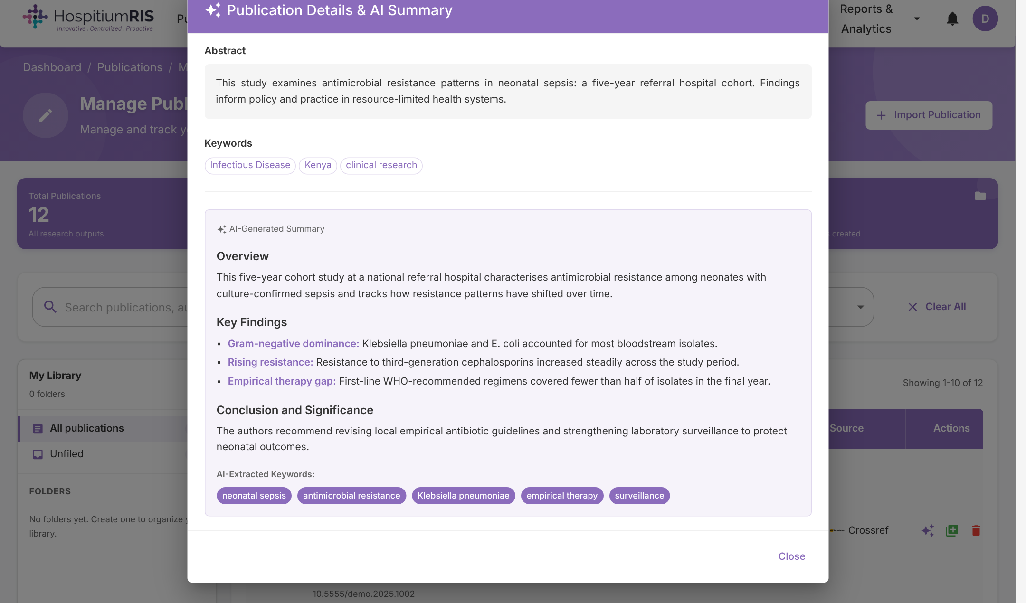



AI summaries: understand any paper in seconds
One click on any publication produces a structured, plain-language brief.
Consistent structure
Overview, key findings and significance for every paper.
Keyword extraction
AI tags improve search, reporting and expertise mapping.
Batch processing
Summarise a whole department's output in one run.
For non-specialists
Leadership, funders and communications teams get the point fast.
Notes:
Demo point: open any publication and click the AI Preview icon. HospitiumRIS sends the title and abstract to the configured AI model and returns a structured summary with key findings and extracted keywords. This helps research offices report on outputs, helps communications teams write news items, and helps leadership understand work outside their own specialty. Summaries are clearly labelled as AI-generated. (The summary shown here is illustrative demo content.)

Slide 15
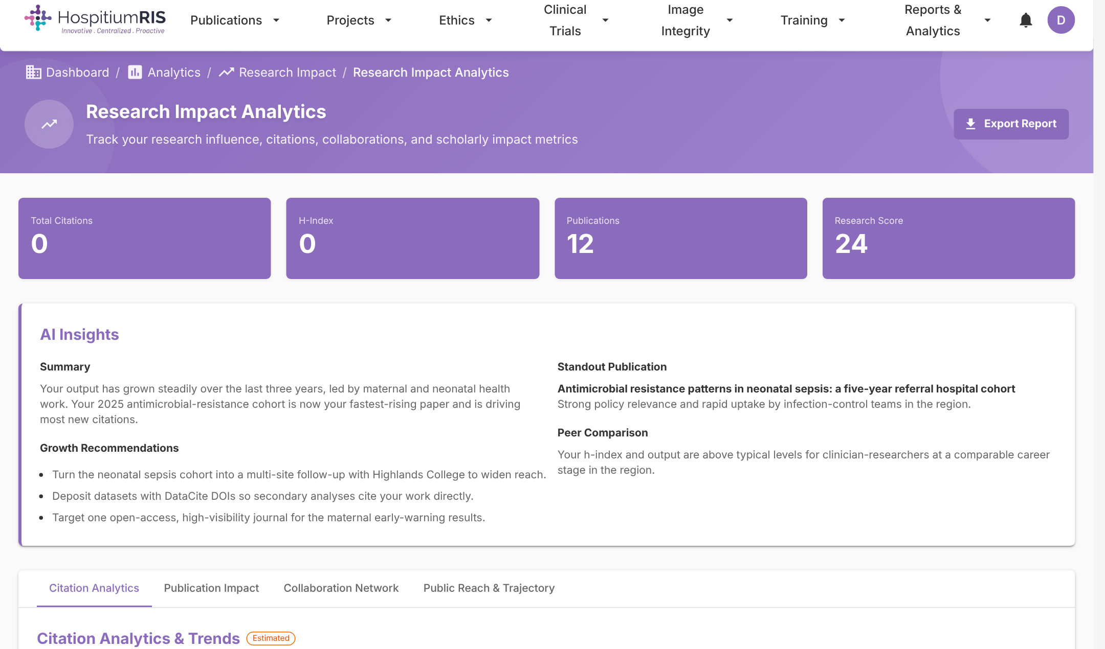

AI insights that tell people what to do next
Impact dashboard
Explains what is driving citations, names the standout paper, recommends how to grow reach.
Compliance dashboard
Highlights approvals nearing expiry, open ethics conditions and integrity checks to run.
Projects & grants dashboard
Summarises the pipeline, flags revisions and overdue milestones, suggests the next action.
Always available: if the AI service is unreachable, dashboards fall back to rule-based insights, so pages never break.
Notes:
Dashboards usually show numbers and leave people to interpret them. HospitiumRIS adds an AI insights panel to the impact, compliance and projects dashboards. It reads the user's own metrics and returns a short narrative, specific recommendations and a priority to act on. If the AI service is unavailable, the platform falls back to rule-based insights automatically. (Insight text shown is illustrative demo content.)

Slide 16
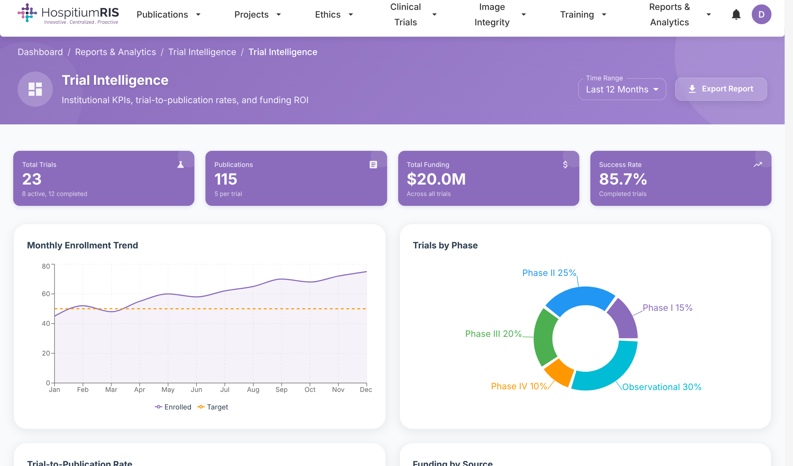




Institutional intelligence for leadership and funders
Portfolio-level views that answer board and funder questions.
Trial intelligence
Enrolment against target, trials by phase and success rate.
Trial-to-publication rate
See which studies turn into published evidence.
Funding by source
Track where research money comes from and what it delivers.
Exportable reports
Board-ready exports over any time range.
Notes:
This is the leadership view. Trial intelligence shows enrolment against targets, the mix of trials by phase, success rates, how often trials lead to publications, and where funding comes from. These are the numbers boards, ministries and funders ask for, available on demand and exportable. (Figures shown are demo data.)

Slide 17



Connected, secure and ready for your IT team
Integrations
Security & governance
Deployment & access
ORCID sign-in and profiles
Crossref and DataCite identifiers
PubMed, OpenAlex, Research4Life
Zotero, Mendeley, EndNote, BibTeX
ClinicalTrials.gov, PACTR, WHO ICTRP
Google Gemini and OpenAI for AI features
ImaChek image integrity analysis
Role-based access for every user type
Institution-verified email domains
Audit trails and activity logs
Admin consoles for security, users and data
Ethics and data-protection workflows
Hosted, or on your own servers via Docker
Multi-institution setup with central admin
19 interface languages
Light and dark modes, adjustable text size
Open, interoperable PID-based design
Notes:
Address the technical and procurement questions early. HospitiumRIS is built on persistent identifiers (ORCID for people, Crossref for publications, DataCite for datasets), so the institution's data stays interoperable. Access is role-based, institutional email domains are verified, and activity is logged for audit. It can be hosted for the client or deployed on their own infrastructure with Docker, and supports multiple institutions under one central administration.

Slide 18
What changes for your institution
 | Today | With HospitiumRIS
Research register | Spreadsheets per department | One live register of projects, trials and outputs
Ethics & approvals | Paper forms and email chains | Online submission, review and expiry alerts
Funding | Grant status tracked by memory | Pipeline from call to award, with audit trail
Manuscripts | Drafts in email attachments | Co-authoring with versions and citations
Reporting | Weeks of chasing researchers | Dashboards and exports on demand
Visibility | Outputs hard to find | PID-linked profiles and publications
Insight | Reading every paper and report by hand | AI summaries and recommended next actions
Notes:
Walk through the rows the prospect cares about most rather than reading every line. The theme is the same in each row: work that today depends on manual effort and individual memory becomes a shared, live system. This is where the return on investment comes from — less administrative time, faster approvals, and better funder reporting.

Slide 19





A clear path to go-live
We handle the heavy lifting; your team focuses on decisions and adoption.
PHASE 1
PHASE 2
PHASE 3
PHASE 4
PHASE 5
Discover
Configure
Migrate
Train
Go live
Map your workflows, review stages, ethics forms and reporting needs.
Set up roles, review pipelines, verified domains and branding.
Import publications, researcher profiles, active proposals and approvals.
Role-based training for researchers, reviewers and administrators.
Launch with support, then review adoption and analytics together.
Included: onboarding support, user guides and handbook, multilingual interface, and regular product updates — including new AI features as they ship.
Notes:
Walk through the five phases. Discover: we map their current workflows and forms. Configure: roles, review pipelines and verified domains. Migrate: publications are imported automatically from PubMed, Crossref and OpenAlex, and active proposals and approvals are brought across. Train: short role-based sessions. Go live: launch with support and review adoption together. Adjust timeframes and what is included to match your commercial offer.

Slide 20
Let's get started
A low-risk path from first look to institution-wide rollout.
1
2
3
Tailored demo
Pilot
Rollout
A walkthrough on your own workflows: proposals, ethics, trials or grants.
One department or research unit, with your data imported and users onboarded.
Institution-wide launch, training and integration with your identity and reporting needs.
hospitium.hospitiumris.org
Developed by TCC Africa — Training Centre in Communication
Notes:
Close with a clear ask. Propose a tailored demo using the prospect's own workflows, then a pilot with one department or research unit, then institution-wide rollout. Agree on the pilot scope and a date for the demo before leaving the meeting. Add your own contact details and any commercial terms before sending this deck.

